Slide 1

OPENSHIFT ENTERPRISE
TRAINING
PRESENTED
BY
GRANT
SHIPLEY
MICIAH
MASTERS

Slide 2




AGENDA
Introductions
Overview
Installation
Usage

Slide 3

WHO AM I?
Senior Manager, Product Marketing
Really, I am a Developer Evangelist
Red Hat (7 Years), Novell (2 years), Caldera / SCO (5 years)
Java / PHP / Node.js / Mobile /MongoDB / MySQL/ PostgreSQL
Open source projects

Slide 4

WHO IS MICIAH?
Miciah Masters
Software Engineer, OpenShift Enterprise
Started at Red Hat in July 2012
C / shell / GNU/Linux system administration
Open source project

Slide 5

WHO ARE YOU?

Slide 6

WHAT WILL YOU LEARN?
How to install OpenShift Enterprise
How to configure and administer OpenShift Enterprise
How to add cartridges
How to use OpenShift Enterprise for deployment
How to use OpenShift Enterprise for development

Slide 7

ASSUMPTIONS
You want to learn how to use OpenShift Enterprise
You can write some form of code
You have your own laptop
You will ask questions
You know how to use Red Hat Enterprise Linux
You have an SSH client installed on your laptop

Slide 8

TRAINING SCHEDULE
Some lecture
Mostly labs
Let’s set our break schedule
Lunch (the most important thing)

Slide 9

BORING........
DEMO

Slide 10


HOUSEKEEPING
CLASS MATERIAL
OpenStack
Lab Manual
Online Material
SWAG
Two virtual machines
Broker Host
Node Host
RHEL Pre-installed
32 Labs (less talking - more doing)
Printed copy
training.runcloudrun.com
HTML and PDF manual
Source code and scripts
T-Shirts
USB Bottle openers
Reference cards

Slide 11
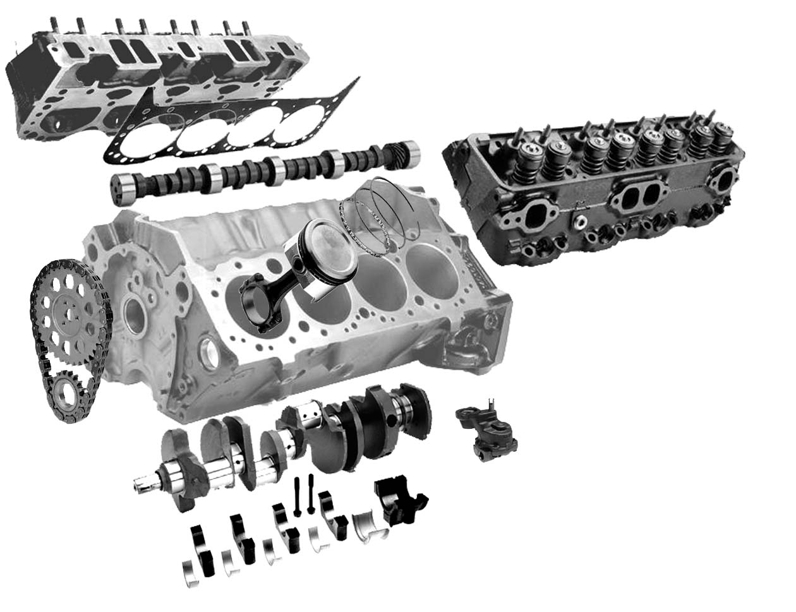
LAB MANUAL
Divided into three parts
Installation and Configuration
Administration
Usage

Slide 12

OpenShift
HISTORY

Slide 13

OpenShift
CLOUD OVERVIEW

Slide 14

LEVEL SET
Cloud computing will
Feed all the children
Shelter all the homeless
Create world peace
Save us from the zombie apocalypse
Automagically correct your terrible photos

Slide 15
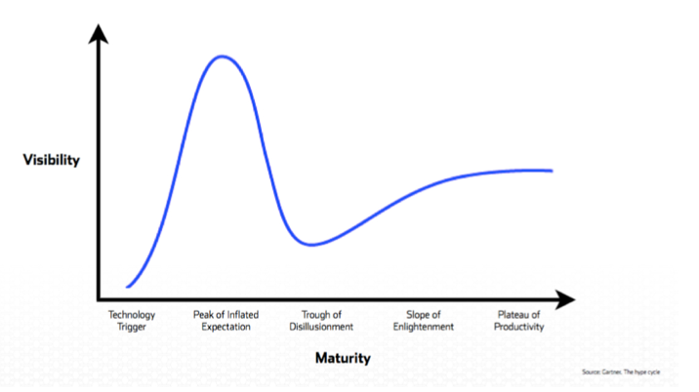

HYPE CYCLE

Slide 16
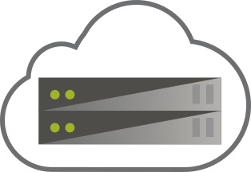
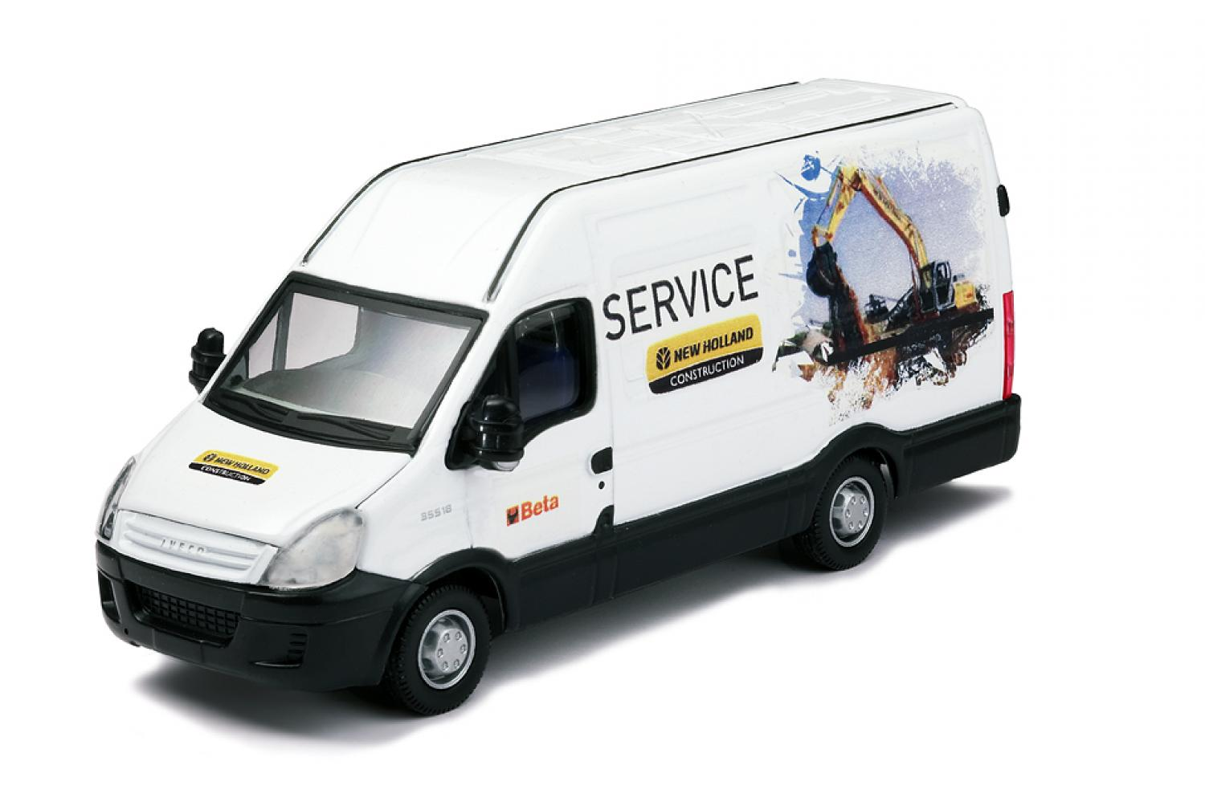
IaaS
Servers in the Cloud
You must build and manage everything
(OS, App Servers, DB, App, etc.)
“How do I use this?”

Slide 17



SaaS
Someone else’s app in the Cloud (CRM, etc.)
You are restricted to the features of the 3rd Party application
“I’m not sure this does what I need.”

Slide 18


PaaS
Quickly build the Application that YOU need for
Your Group, your Enterprise, your next great idea!
Big data, mobile, social
You code the application, We run it for you
Leverage the ease, scale and power of the Cloud
Code
Deploy
Enjoy

Slide 19

EVERYONE GETS ALONG
Operations care about stability and performance
Developers just want environments without waiting
OpenShift Enterprise creates a peaceful
environment for both parties

Slide 20
OpenShift
OPENSHIFT OVERVIEW

Slide 21



FLAVORS OF OPENSHIFT
Open Source Project
origin
Public Cloud Service
On-premise or Private Cloud Software

Slide 22
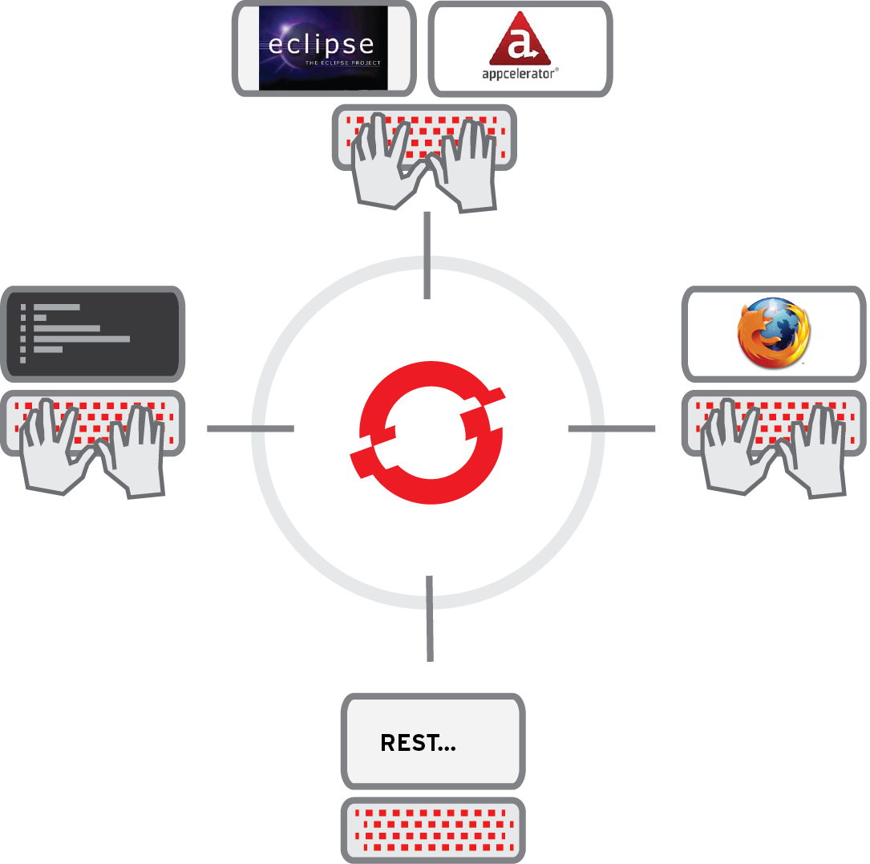
INTERACTIONS
Developer IDE
Integrations
Command Line
Tooling
Web Browser
Console
REST APIs

Slide 23

RUNS ON IaaS
OpenShift Enterprise is a PaaS that runs on top of..... Infrastructure
Amazon EC2
Rackspace
Bare Metal
OpenStack
RHEV
VMWare

Slide 24
FOUNDATION
The foundation of OpenShift Enterprise is Red Hat Enterprise Linux
RHEL
RHEL
RHEL
RHEL
RHEL
RHEL

Slide 25

SERVER TYPES
Each OpenShift Enterprise server will be one of the following types:
Broker Host
Node Host

Slide 26
BROKER
An OpenShift Broker can manage multiple node hosts.
Nodes are where User Applications live.
RHEL
RHEL
RHEL
Brokers
Node
Node

Slide 27
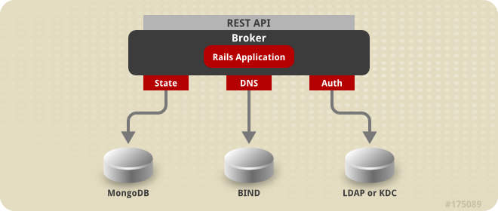
BROKER
The Broker is responsible for state, DNS, and authentication.

Slide 28
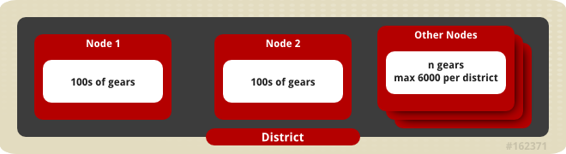
NODE
The node hosts are responsible for holding application gears.

Slide 29
SELINUX
SELinux Policies securely subdivide
the Node instances.
RHEL
RHEL
Brokers
Node
Node

Slide 30
GEARS
OpenShift GEARS represent secure containers in RHEL
RHEL
RHEL
Brokers
Node
Node

Slide 31

WORKFLOW
Web Console
Eclipse IDE
Cmd Line
OpenShift
Gear
RHEL
RHEL
Brokers
Node
Node

Slide 32
CARTRIDGES
Web Console
Eclipse IDE
Cmd Line
MYSQL
JBOSS
RHEL
RHEL
Brokers
Node
Node

Slide 33
CARTRIDGES
Java
MySQL
PHP
Postgres
CUSTOM
Python
Etc.
Ruby
Etc.
OpenShift Default
Cartridges

Slide 34
WORKFLOW
Git Protocol / ssh
Push
Developer pushes application code via GIT source code management system
Code
Git
Repo
MySQL
JBoss
RHEL
RHEL
RHEL
Broker
Node
Node
Node
Notes:
So, once the Gear is fully configured and Cartridges are installed, the Developer can then begin coding. As code is completed, the Developer pushes the code to OpenShift via the Git protocol. Git is a popular Source Code Control system used in the Open Source development world. A Git repository is created in the Gear and the Developer uses the Git “Push” command, or the IDE, to push the latest code into the repository over an SSH encrypted channel using the Git protocol.
Depending on the programming language, once the code is pushed, the application will show the updates immediately. This accelerates the Application Development Lifecycle by providing immediate feedback on application changes.
<next slide>
34

Slide 35
SCALING
HA-Proxy
Code
Code
Code
Java
Java
Java
RHEL
MySQL
Notes:
And, once the application is launched within the OpenShift PaaS, OpenShift provides the elasticity expected in a Cloud Application Platform by automatically scaling the application as needed to meet demand.
When created, applications can be flagged as “Scalable” (some apps may not want to be scaled). When OpenShift sees this flag, it creates an additional Gear and places an HA-Proxy software load-balancer in front of the application. The HA-Proxy then monitors the incoming traffic to the application. When the number of connections to the application crosses a certain pre-defined threshold, OpenShift will then horizontally scale the application by replicating the application code tier of the application across multiple Gears.
For JBoss applications, OpenShift will scale the application using JBoss Clustering which allows stateful or stateless applications to be scaled gracefully. For Ruby, PHP, Python, and other script-oriented languages, the application will need to be designed for stateless scaling where the application container is replicated across multiple gears. The Database tier is not scaled in OpenShift today.
Automatic application scaling is a feature that is unique to OpenShift among the popular PaaS offerings that are out there.
Automatic scaling of production applications is another example of how OpenShift applies automation technologies and a cloud architecture to make life better for both IT Operations and Development.
<next slide>
35

Slide 36
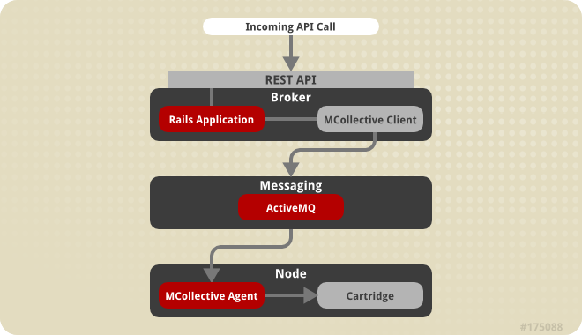
COMMUNICATION
Communication from external clients occurs through the REST API
The Broker then communicates through the messaging service to nodes

Slide 37
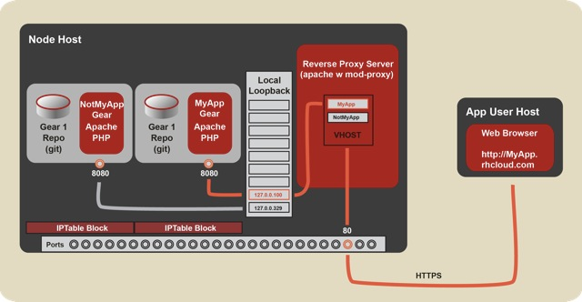
HTTP FLOW
Notes:
OpenShift Origin - Port Proxy
Linux handles the loopback interface's 127.0.0.0/8 address block specially: A request from an address in this block can only go to an address in the same block (put another way, a connection on the loopback interface is confined to the loopback interface). OpenShift uses this fact to contain hosted applications: a gear is prohibited by iptables from listening on an external network interface, and so a given gear can only respond to connections that come from processes on the same node.
For the common case of Web connections, the system Apache instance acts as a reverse proxy, forwarding requests that come in on the external interface to the appropriate 127.x.y.z address; see the documentation on the node component.
However, sometimes gears need to accept other types of connections. The two most common such scenarios are the following:
A gear needs to connect to another gear (which may be on the same node or another node).
A gear needs to listen for connections on a public interface besides HTTP connections to port 80.
For example, a game server needs to expose a port to receive incoming connections from clients, and a database needs to expost a port so that other gears can connect to it.
To meet these needs, OpenShift uses haproxy to proxy TCP connections between an external-facing network interface and the loopback interface. Each gear is assigned five exposable ports, and the gear may establish a forwarding rule for each of these ports to forward connections on the the port on the external interface to an arbitrary port on the gear's assigned loopback address.
To provide haproxy with adequate ports, we shift the ephemeral port range down to 15000-35530, so that Linux will not use ports outside of this range for connections for which no port is given explicitly. This means that ports 35531-65535 will be available for haproxy's exclusive use.
Note: Given that each gear is assigned 5 ports, this imposes a limit of 6000 gears per node.
The interaction with haproxy is implemented on the cartridge side in cartridges/openshift-origin-cartridge-abstract/abstract/info/lib/network
and:
OpenShift Origin - Node Component
Hosted applications are run in containers called "gears." These gears are run on hosts (which can be physical hosts or virtual machines) called "nodes."
Each node runs a system Apache instance with mod_proxy that listens on port 80 on a public-facing network interface. Each gear is assigned an address in the 127.0.0.0/8 block, and a hosted Web application listens on port 8080 on its assigned private 127.x.y.z address.
When a Web client requests a URL for a hosted Web application, the request goes to the node's system Apache instance. The system Apache instance examines the virtual-host header (the "Host:" HTTP header) and dispatches the request to the 127.x.y.z:8080 private address of the appropriate gear.
For an explanation of how connections other than regular HTTP connections are handled, see the documentation on the port-proxy.

Slide 38
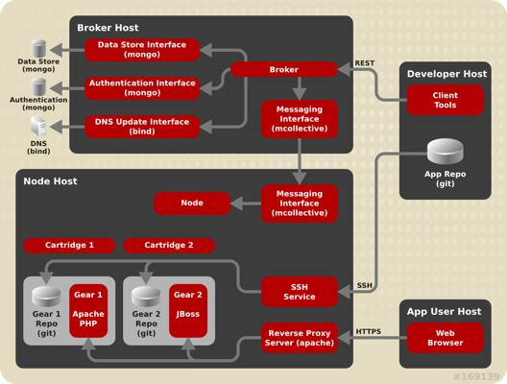
COMPLETE PICTURE

Slide 39

LAB 1
Read the overview chapter
Register the system and add subscriptions
Update the operating system
Configure the system clock

Slide 40

LAB 1
15 MINUTES

Slide 41
LAB 1
QUESTIONS?

Slide 42

LAB 2
BIND
Environment variables
Create a database for your example.com domain
Use the new nameserver
Gotchas

Slide 43
LAB 2
20 MINUTES

Slide 44
LAB 2
QUESTIONS?

Slide 45

LAB 3
Configure dhclient
Configure hostname

Slide 46
LAB 3
5 MINUTES

Slide 47
LAB 3
QUESTIONS?

Slide 48
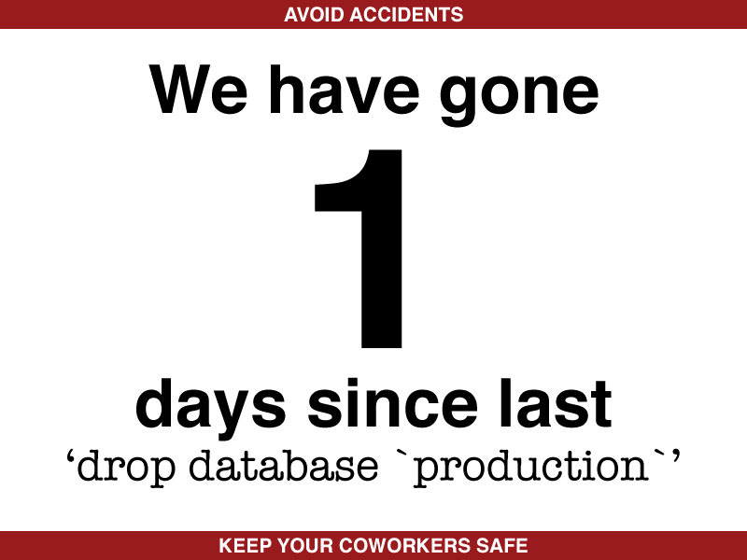

LAB 4
Install MongoDB
Configure MongoDB
Verify MongoDB is working

Slide 49
LAB 4
10 MINUTES

Slide 50
LAB 4
QUESTIONS?

Slide 51

LAB 5
Install ActiveMQ
Configure ActiveMQ
Update firewall
Verify it works

Slide 52
LAB 5
10 MINUTES

Slide 53
LAB 5
QUESTIONS?

Slide 54

LAB 6
Install MCollective Client
Configure MCollective Client

Slide 55
LAB 6
10 MINUTES

Slide 56
LAB 6
QUESTIONS?

Slide 57

LAB 7
Install Broker application
Generate access keys
Configure SELinux and Boolean variables
Changing Broker configuration

Slide 58
LAB 7
15 MINUTES

Slide 59
LAB 7
QUESTIONS?

Slide 60

LAB 8
Configure Broker plugins
DNS plugin
Authentication plugin
Create MongoDB account
Configure SELinux and Boolean variables
Changing Broker configuration

Slide 61
LAB 8
15 MINUTES

Slide 62
LAB 8
QUESTIONS?

Slide 63
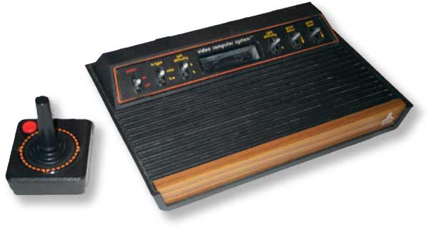
LAB 9
Install web console
Configure authentication for web console

Slide 64
LAB 9
10 MINUTES

Slide 65
LAB 9
QUESTIONS?

Slide 66

LAB 10
Configure node host
Set system clock
Register node with DNS entry
Configure SSH authentication

Slide 67
LAB 10
20 MINUTES

Slide 68
LAB 10
QUESTIONS?

Slide 69

LAB 11
Install MCollective on node host
Configure MCollective on node host
Using STOMP (Simple Text Orientated Messaging Protocol

Slide 70
LAB 11
10 MINUTES

Slide 71
LAB 11
QUESTIONS?

Slide 72

LAB 12
Install core node packages
Install cartridges / runtimes node host will support

Slide 73
LAB 12
10 MINUTES

Slide 74
LAB 12
QUESTIONS?

Slide 75
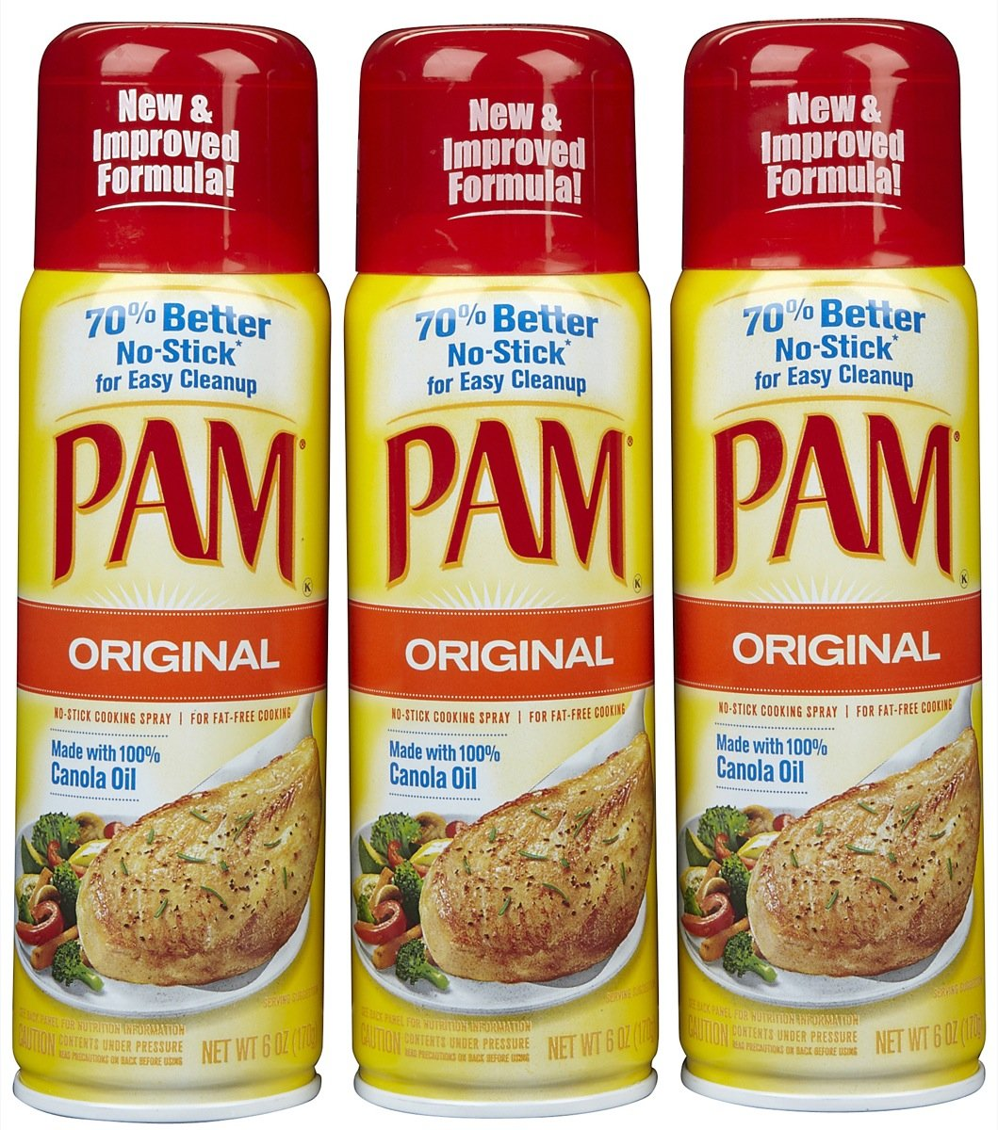
LAB 13
Configure PAM namespace module
Configure Linux Control Groups (cgroups)
Configure disk quotas

Slide 76
LAB 13
10 MINUTES

Slide 77
LAB 13
QUESTIONS?

Slide 78

LAB 14
Configure SELinux (even more)
Configure System Control Setting

Slide 79
LAB 14
5 MINUTES

Slide 80
LAB 14
QUESTIONS?

Slide 81

LAB 15
Configure SSH to pass GIT_SSH variable
Configure port proxy
Reboot the node
Finally, we get to test the setup!

Slide 82
LAB 15
20 MINUTES

Slide 83
LAB 15
QUESTIONS?

Slide 84

LAB 16
Configure local machine (your laptop), for DNS resolution

Slide 85
LAB 16
10 MINUTES

Slide 86
LAB 16
QUESTIONS?

Slide 87

LAB 17
List available cartridges
Install JBoss cartridges
Clearing broker application cache
Install PostgreSQL cartridge
Install DIY cartridge

Slide 88
LAB 17
10 MINUTES

Slide 89
LAB 17
QUESTIONS?

Slide 90

LAB 18
Managing resources
Default gear quota and size
Number of allowed gears
Configuring gear types for a user

Slide 91
LAB 18
10 MINUTES

Slide 92
LAB 18
QUESTIONS?

Slide 93

LAB 19
Introduction to districts
Enable districts
Populate district with node host
Configure district capacity

Slide 94
LAB 19
10 MINUTES

Slide 95
LAB 19
QUESTIONS?

Slide 96

LAB 20
Install RHC client tools
Windows
OS X
Linux
Any OS with Ruby

Slide 97
LAB 20
15 MINUTES

Slide 98
LAB 20
QUESTIONS?

Slide 99
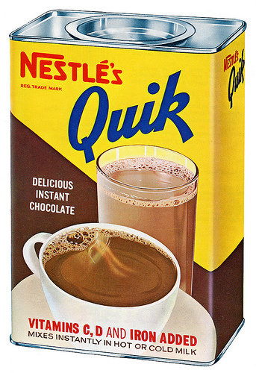
LAB 21
Configure RHC tools (broker.example.com)
Run rhc setup

Slide 100
LAB 21
10 MINUTES

Slide 101
LAB 21
QUESTIONS?

Slide 102

LAB 22
Creating our first application (wait, really? – Yes, finally.)
Understanding directory structure
Edit the source code
Deploy changes to your gear
Enable hot deployment

Slide 103
LAB 22
30 MINUTES

Slide 104
LAB 22
QUESTIONS?

Slide 105

LAB 23
Managing Applications
Cleaning up applications
Start / Stop / Restart applications
Viewing application details
SSH to application gear
Viewing log files
Adding custom domain names
Deleting an application

Slide 106
LAB 23
30 MINUTES

Slide 107
LAB 23
QUESTIONS?

Slide 108

LAB 24
Using cartridges
Adding MySQL to an application
Modify PHP code to use MySQL
Managing cartridges
Using port forwarding

Slide 109
LAB 24
30 MINUTES

Slide 110
LAB 24
QUESTIONS?

Slide 111

LAB 25
Using the web console

Slide 112
LAB 25
10 MINUTES

Slide 113
LAB 25
QUESTIONS?

Slide 114

LAB 26
How scaling works
Create a scaled application
Automatic scaling
Manual scaling

Slide 115
LAB 26
15 MINUTES

Slide 116
LAB 26
QUESTIONS?

Slide 117

LAB 27
Create a DIY application
Start and Stop scripts

Slide 118
LAB 27
10 MINUTES

Slide 119
LAB 27
QUESTIONS?

Slide 120

LAB 28
Create a JBoss EAP application
Adding marker files
Building a TODO application
Enable CDI
Creating RESTful web service
Deploying Java applications

Slide 121
LAB 28
30 MINUTES

Slide 122
LAB 28
QUESTIONS?

Slide 123

LAB 29
Using Jenkins for CI
Adding a Jenkins server
Configuring Jenkins builder
Adding Jenkins to your Java application

Slide 124
LAB 29
30 MINUTES

Slide 125
LAB 29
QUESTIONS?

Slide 126

LAB 30
Using JBoss Tools
Downloading Eclipse
Installing JBoss Tools
Configure JBoss Tools
Creating applications
Viewing logs
Port forwarding
Setting up database in Eclipse

Slide 127
LAB 30
30 MINUTES

Slide 128
LAB 30
QUESTIONS?

Slide 129

LAB 31
Using quick starts

Slide 130
LAB 31
10 MINUTES

Slide 131
LAB 31
QUESTIONS?

Slide 132

LAB 32
Creating your own quick start

Slide 133
LAB 32
30 MINUTES

Slide 134
LAB 32
QUESTIONS?

Slide 135

DONE!

Slide 136
OpenShift 2011-2013 Roadmap
OpenShift Enterprise 1.0
Origin Productization
2.0
PaaS Admin
Console
Crossed the
100K apps mark
1.3
Admin Console(Preview)
Cartridge Updates
Developer Preview
Launched
1.1
Fixes
Dev Console
1.2
Websockets
New Cartridge
More Investment on:
-Advanced DB & FS Scaling
-Visibility and Management
-Governance & Charge-back
-ALCM Improvements
-More IaaSs & Cartridges
Partners I
OPENSHIFT
Partners III
Enterprise
Partners I
Online
Origin
Full Service GA
Pay per use + Add-ons
Partners II
Community Maturity
Project
Launched
Advanced
Cartridge
Spec
2011
2012
2013
Notes:
OpenShift Origin is the name of the public open source project for the PaaS management and automation system that has been running OpenShift.com since April 2011.
OpenShift Origin is licensed under the Apache 2.0 license which makes it “business friendly” and it is available as Source code, RPMs, and a .ISO or LiveCD for standing up an Origin PaaS instance on your PC.
OpenShift Origin has a vibrant user community accessible via IRC, Email, and online discussion forums.
For Red Hat, OpenShift Origin is the “Upstream” project for both OpenShift Enterprise and OpenShift OnLine. This means that Red Hat takes the stable builds of the open source project and tests and packages them as a commercially supported offering.
OpenShift Origin is to OpenShift Enterprise as Fedora is to RHEL.
<next slide>
136

Slide 137
Upcoming Releases
OpenShift Enterprise 1.1 (Jan 31)
Developer Console fully supported, bug fixes & doc updates
OpenShift Enterprise 1.2 (~May)
Integrate new cartridge format, Web sockets, SSL, other upstream
Rebase
OpenShift Enterprise 1.3 (~Aug)
RHEL cartridge updates, Admin Console (Tech Preview), HA fixes, bugs
OpenShift Enterprise 2.0 (~Nov)
Admin Console, additional JBoss cartridges (TBD)
Rebase
Notes:
137
So, what you need is the ease of use and access of a SaaS application, but you need it with your purpose-built, mission-critical, applications.
PaaS gives you just that. It allows you to quickly and easily build the application that YOU need. Whether this is for your group, your enterprise, or your next BIG IDEA, you can build it and launch your specific code on a PaaS and not have to deal with the underlying infrastructure, middleware, and management headaches.
Because of the built-in auto-scaling and elasticity provided by the PaaS infrastructure, PaaS's are ideal for modern data-hungry Big Data, Mobile, and Social applications.
With a PaaS, you can focus on what you should be focused on... your application code.
And let the Cloud provide what it is suppose to: Ease, Scale and Power

Slide 138
Product Feedback
Top Features & Enhancements Identified by OSE Prospects
Cartridge Enhancements
New Carts (MongoDB, Node.js, more JBoss products)
Updates Carts (update RHEL runtimes)
Custom Cartridges (easier to create; documented)
Administration
Usage Metering
Admin Console
App/Infrastructure Monitoring Integration
High Availability
HA Proxy
Active-Active, Active-Passive
Notes:
138
So, what you need is the ease of use and access of a SaaS application, but you need it with your purpose-built, mission-critical, applications.
PaaS gives you just that. It allows you to quickly and easily build the application that YOU need. Whether this is for your group, your enterprise, or your next BIG IDEA, you can build it and launch your specific code on a PaaS and not have to deal with the underlying infrastructure, middleware, and management headaches.
Because of the built-in auto-scaling and elasticity provided by the PaaS infrastructure, PaaS's are ideal for modern data-hungry Big Data, Mobile, and Social applications.
With a PaaS, you can focus on what you should be focused on... your application code.
And let the Cloud provide what it is suppose to: Ease, Scale and Power

Slide 139
Product Feedback (cont.)
Other Feature Requests
Larger Node Sizes for Bare Metal Deployments
Multi-level Authorization (Groups/Roles) & Enabling Team Development
Network Isolation & Access for Gears
IaaS/Virt Integration for Automated Provisioning of Nodes/Brokers
Chargeback Integration
Database Tier Autoscaling
CDN Integration
Localization
For more details and to provide feedback see:
http://etherpad.corp.redhat.com/OpenShiftEnterprise-ReleasePlanning
Notes:
139
So, what you need is the ease of use and access of a SaaS application, but you need it with your purpose-built, mission-critical, applications.
PaaS gives you just that. It allows you to quickly and easily build the application that YOU need. Whether this is for your group, your enterprise, or your next BIG IDEA, you can build it and launch your specific code on a PaaS and not have to deal with the underlying infrastructure, middleware, and management headaches.
Because of the built-in auto-scaling and elasticity provided by the PaaS infrastructure, PaaS's are ideal for modern data-hungry Big Data, Mobile, and Social applications.
With a PaaS, you can focus on what you should be focused on... your application code.
And let the Cloud provide what it is suppose to: Ease, Scale and Power

Slide 140
OpenShift Enterprise Pricing Based on OpenShift Nodes for correlation to PaaS Capacity
Product and Price
SKU |  | Description | USD | EUR | GBP
 |  |  | 1 Yr | 1 Yr | 1 Yr
OpenShift Enterprise
MCT2736 | OpenShift Enterprise Standard, 2 Core, 8 GB |  | $5,500 | € 4,400 | £3,793
MCT2735 | OpenShift Enterprise Premium, 2 Core, 8 GB |  | $8,000 | € 6,400 | £5,517
MCT2738 | OpenShift Enterprise Standard, 4 Core, 32 GB |  | $13,500 | € 10,800 | £9,310
MCT2737 | OpenShift Enterprise Premium, 4 Core, 32 GB |  | $20,000 | € 16,000 | £13,793
MCT2748 | JBoss Enterprise Application Platform for OpenShift Enterprise Standard, 2 Core, 8 GB |  | $825 | € 660 | £569
MCT2739 | JBoss Enterprise Application Platform for OpenShift Enterprise Premium, 2 Core, 8 GB |  | $1,200 | € 960 | £828
MCT2749 | JBoss Enterprise Application Platform for OpenShift Enterprise Standard, 4 Core, 32 GB |  | $1,650 | € 1,320 | £1,138
MCT2740 | JBoss Enterprise Application Platform for OpenShift Enterprise Premium, 4 Core, 32 GB |  | $2,400 | € 1,920 | £1,655
MCT2741 | OpenShift Enterprise Broker Infrastructure |  | $0 | $0 | $0
SER0419 | 30 Day Unsupported OpenShift Enterprise, 2 Core, 8 GB Evaluation |  | $0 | $0 | $0
SER0420 | 30 Day Unsupported JBoss Enterprise Application Platform for OpenShift Enterprise, 2 Core, 8 GB Evaluation |  | $0 | $0 | $0
SER0421 | OpenShift Employee Subscription |  | $0 | $0 | $0
 |  |  |  | *Euro = .8 USD
 |  |  |  | *GBP = .68966 USD

Slide 141
How Many OpenShift Brokers Do I Need?
Brokers are RHEL instances that act as a central controller for a set of Nodes
Typical deployment will have a set of Nodes connected to a Broker
All customers need at least 1 OpenShift Broker, so be sure to add it to your quote!
We don’t charge customers for Brokers ($0 SKU) and you can add up to 20 max per customer
Customer’s may need more than 1 Broker if they:
Want to make the Broker tier redundant for HA reasons;
Notes:
141
141

Slide 142
How Many OpenShift Nodes Do I Need?
Nodes are RHEL instances where user applications run
Nodes are multi-tenant, meaning multiple apps run on each
Nodes are split up into individual containers or “Gears”, that are where application runtimes are deployed
Nodes have finite capacity, meaning there are limits to how many total Gears a single node can run
Notes:
142
142

Slide 143
How Many OpenShift Nodes Do I Need?
Nodes are sold in specific instance sizes (two sizes to start)
2 Core, 8 GB (“Small” Node) and 4 Core, 32 GB (“Medium” Node)
Nodes can be split up into Gears of different sizes
Small Gear (512 MB), Medium Gear (1 GB), Large Gear (2GB), etc.
Customer can define gear size & name associated to it
Number of Gears a Node can run can be estimated per the table below
Note the maximum number Gears per Node is not guaranteed and can vary based on application
Node Size | Small Gears (512 MB) | Medium Gears (1 GB) | Large Gears (2 GB)
2 Core, 8 GB | 25 | 12 | 6
4 Core, 32 GB | 100 | 50 | 25
Notes:
143
143

Slide 144
How Many OpenShift Nodes Do I Need?
To determine how many Nodes a customer will need, ask:
How much capacity (i.e. total # of applications) do you want to be able to support in your PaaS?
One application consumes at least 1 Gear
One application may consume 3 or more Gears if auto-scaling is enabled and/or if the DB (i.e. MySQL, Postgresql) runs in OpenShift
What types of applications do you want to run?
LAMP app runtimes can use Small Gears (512 MB)
JBoss EAP typically requires Medium or Large Gears (1 GB or 2 GB)
Do you want PaaS environments for Development, Testing, Staging, Production, etc. or all of the above?
Notes:
144
144

